Slide 1

An Introduction to ARU Harvard Referencing
The Guide to the Harvard System of Referencing

Slide 2
What is referencing?
Referencing is the acknowledgement of the sources of information you use in writing your work.
It appears in a particular style, depending on the referencing system you use.
This is an introduction to the ARU version of the Harvard style.

Slide 3
Why reference?
Good Academic Practice to acknowledge your sources
Demonstrates wider reading
Gives evidence and credibility for arguments
Shows where to find information sources
Transferable skill
Avoids Plagiarism (the academic offence of appearing to take credit for the ideas of others)

Slide 4
When and what to reference?
When - everything except your own ideas, reflections or experiences and also common knowledge (either for the general public or within your subject area)
What - not just text, but also statistics, graphs, tables, images… (everything!)
So – keep a good record of all your sources

Slide 5
There are two parts of Harvard referencing
The in-text reference or citation - authorship, date;
2. The reference list at the end of your assignment, arranged A-Z by author.

Slide 6
In-text referencing can be direct or indirect – it’s your choice
Direct – the author(s) surname appear in your sentence and the date in brackets:
Example
Carson in an earlier paper (1970) argues that ...on the other hand, Jones et al. (1983) has reported that in the future...
Notes:
Note that the in-text reference should be placed close to the particular idea you are expressing.

Slide 7
In text referencing - indirect
Both the author(s) surname and date appear in brackets:
Example
An earlier paper (Carson, 1970) argues that…….on the other hand, it has been reported (Jones, et al., 1983) that ….

Slide 8
In text – more than one author?
If an item has one, two or three authors put in all authors’ surnames or organisation names
Examples:
Bloggs (2016)
Department of Health (2019)
Bloggs and Woods (2015)
Bloggs, Woods and Smith (2014)
Four or more authors:
Use the first author listed on the item then et al (meaning ‘and others’ in Latin)
Example:
Stephenson, et al (2012)
Notes:
Note – when you do not have a human author, it can be an organisation, a ‘corporate author’.

Slide 9
What to include in a full reference? A five point plan
Who wrote it (Author)
When was it written (Date – year)
What is it called (Title)
What is it – Format (only if it’s online)
Where to find it

Slide 10
5 point plan – format (if online)
1 Authorship
2 Year
3 What’s it called
4 Format […] [pdf] [online] [e-book] [e-journal]
5 Where to find it
Notes:
Format is used for online sources and the particular format depends on what is being referenced, such as a pdf document, a webpage, an ebook or ejournal article.

Slide 11
5 point plan – where to find it
1 Authorship
2 Year
3 What’s it called
4 Format
5 Where to find it – this bit varies, depending on the type of information being referenced

Slide 12
5 Where to find it
Decide what type of information source you are using:
Books - Place and Publisher
Journal Articles - Volume, Issue and Pages, URL or DOI
Web Pages – Available at <……………> [Accessed DD/MM/YYYY]
PDF document – Available at <……………> [Accessed DD/MM/YYYY]
PDF references are often used for reports, for example:
Department of Health, 2008. Health inequalities: progress and next steps. [pdf] London: Department of Health. Available at: <http://www.dh.gov.uk/en/Publicationsandstatistics/Publications/PublicationsPolicyAndGuidance/DH_085307> [Accessed 9 June 2008].
].
Notes:
Online journal article references require the URL (Uniform Resource Locator or web address) or DOI number (Digital Object Identifier). References for online sources, such as webpages, particularly need the URL and the date you accessed it because the page may get changed or archived. It’s useful to keep a dated copy of the page for your records.

Slide 13
Examples: Books
Book
Wicker, P., 2015. Perioperative practice at a glance. 3rd ed. Chichester: Wiley.
E-book
Wicker, P., 2015. Perioperative practice at a glance. [e-book] 3rd ed. Chichester: Wiley. Available through ARU Library website <https://library.aru.ac.uk> [Accessed 5 October 2018].
Notes:
Note that the titles of books are written in italics. Try to follow the punctuation shown in this and following slides.
Include an edition if your book is a 2nd or later edition, but do not include the edition if it’s a 1st edition. The place of publication should be a town or city.
If it’s a book from the ARU Library, these details will be on the Library Website, but you can also find them inside the book on the title page and the next page.
E-book references also include the format, web address and date accessed.
In-text references just use surnames, but all full references include authors’ initials as well, although not the full first names.

Slide 14
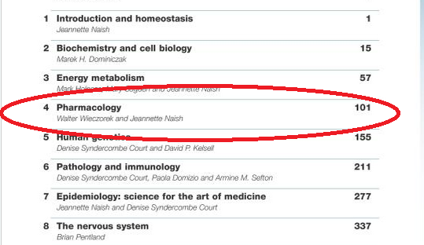
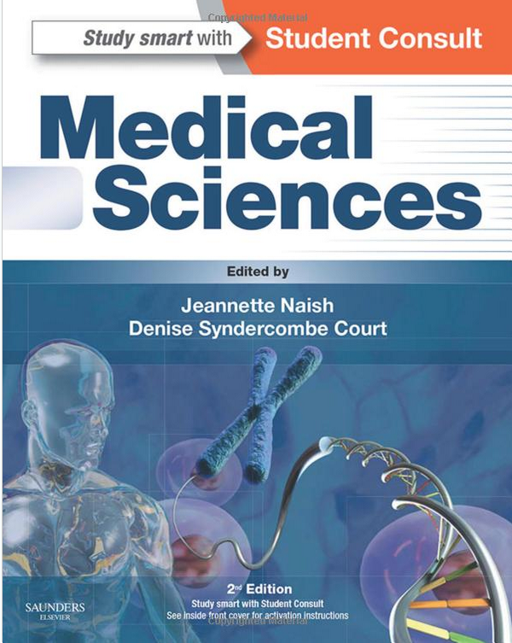
Chapter from an edited book
Chapter details
author, date and chapter title
Wieczorek, W. and Naish, J. , 2015. Pharmacology
Book details
Editors of the book -
Jeannette Naish and Denise Syndercombe Court, book title - Medical Sciences and publisher details
In
Notes:
If you are referencing a chapter from an edited book, you will need to gather information about the chapter and the whole book.

Slide 15
Chapter from an edited book - example
Wieczorek, W. and Naish, J. , 2015. Pharmacology. In: J. Naish and D. Syndercombe Court, eds. 2015. Medical sciences. Edinburgh: Saunders Elsevier. Ch.4.
Notes:
The chapter authors, date and chapter title comes first. Then the word ‘In’ followed by the editors (initials then surnames) and the abbreviation ‘eds’. Then the book date (which may be the same as the chapter date), the book title in italics, place, publisher and chapter number.

Slide 16
Journal Article
Journal article (print)
Lean, M.E.J., 2015. Principles of human nutrition. Medicine, 43 (2), pp.61-65.
E-journal article
Lean, M.E.J., 2015. Principles of human nutrition. Medicine, [e-journal] 43 (2), pp.61-65. Available through: ARU Library website <https://library.aru.ac.uk> [Accessed 30 October 2019].
E-journal article (alternative model with DOI)
Lean, M.E.J., 2015. Principles of human nutrition. Medicine, [e-journal] 43 (2), pp.61-65. https://doi.org/10.1016/j.mpmed.2014.11.009
Notes:
If you are referencing a journal article, you will need to find information about the author(s), date, title of the article, title of the journal (in italics), the volume, part or issue number (in brackets) if one is given and the pages. For online articles, we add the format [e-journal], the source with the web address and the date accessed. If it’s an article from the ARU Library, these details will be on the Library Website, but you can also find them on the article itself. Alternatively, you can use a different model which places the DOI (Digital Object Identifier) after the page numbers.

Slide 17

Webpage example
Wills, D., 2019. 10 great UK open-air theatres you can visit on public transport. [online]
Available at: <https://www.theguardian.com/travel/2019/aug/06/10-open-air-theatres-uk-visit-public-transport-minack-cornwall> [Accessed 1 November 2019].
Note - When a web page does not have a personal author, use the organisation name.
Notes:
For web pages, if you can find a personal author use that in your reference, but otherwise use the name of the organisation responsible for the page.

Slide 18
Your Reference List – should appear at the end of your work, in alphabetical order by author
Extract:
Bloor, M., Frankland, J., Thomas, M. and Robson, K., 2001. Focus Groups in Social Research. London: Sage.
Greenbaum, T., 1998. Handbook for Focus Groups. Thousand Oaks: Sage. Health and Safety Executive (HSE), 2018. How to organise focus groups. [pdf] Available at:<http://www.hse.gov.uk/stress/standards/pdfs/focusgroups.pdf> [Accessed 21 June 2019].
Merton, R., 1987. Focus interviews and focus groups: continuities and discontinuities. Public Opinion Quarterly, 51(1), pp.550-557.
Merton, R. and Kendall P., 2010. The focused interview. American Journal of Sociology, [e-journal] 51, pp.541-557. Available through: ARU Library website <library.aru.ac.uk> [Accessed 20 June 2018].
Stewart, D. W. and Shamadasani, P. N ., 2015. Focus Groups: Theory and Practice. 3rd ed. [e-book] Available through: ARU Library website <library.aru.ac.uk> [Accessed 20 June 2018].
Notes:
Note the four authors in the first example on this list. Although we use only the first named author and ‘et al’ when we have four or more authors in the in-text reference, all of the authors are usually mentioned in the full reference. If there are a very large number of authors, check with your lecturer to see if you should include them all.

